Slide 1
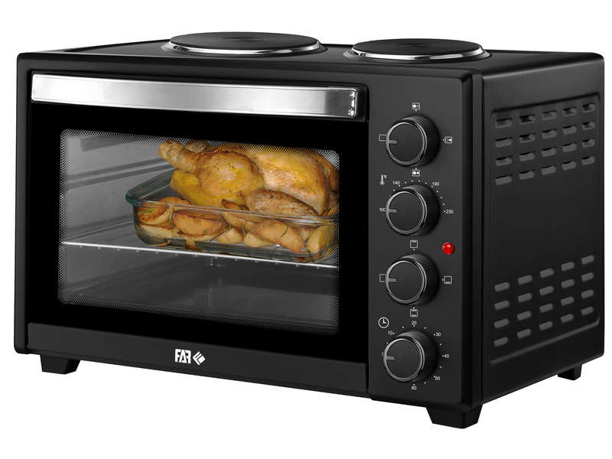
Thermal
Objectives and Modelling
Results of Thermica Simulation
Johan Alberti - INSA
Giuliana Elena Miceli - ISAE

Slide 2
Past objectives :
1. Find an already launched project to study, or use cubesat shop basic components to start a study with simulation
2. Increase skills in software like thermica
3. As soon as possible, start doing this on TOLOSAT
I. Objectives and Modelling

Slide 3
Past objectives :
1. Find an already launched project to study, or use cubesat shop basic components to start a study with simulation
2. Increase skills in software like thermica ✓
3. As soon as possible, start doing this on TOLOSAT ✓
I. Objectives and Modelling

Slide 4
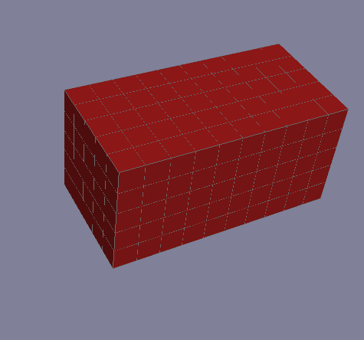
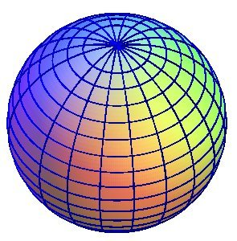
Evolution of the modelisation :
I. Objectives and Modelling

Slide 5
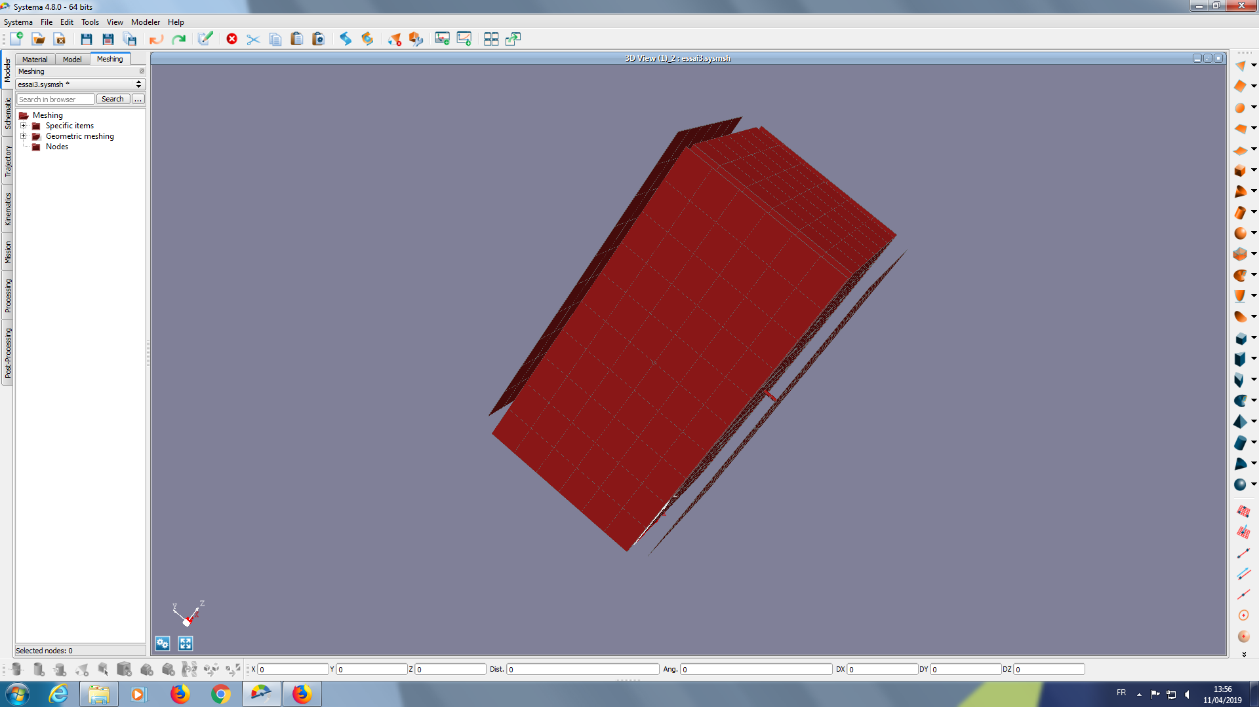
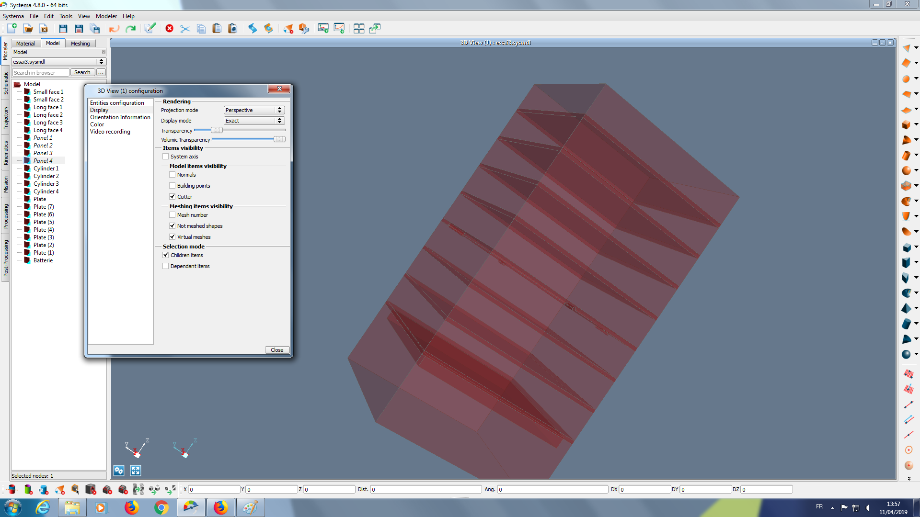
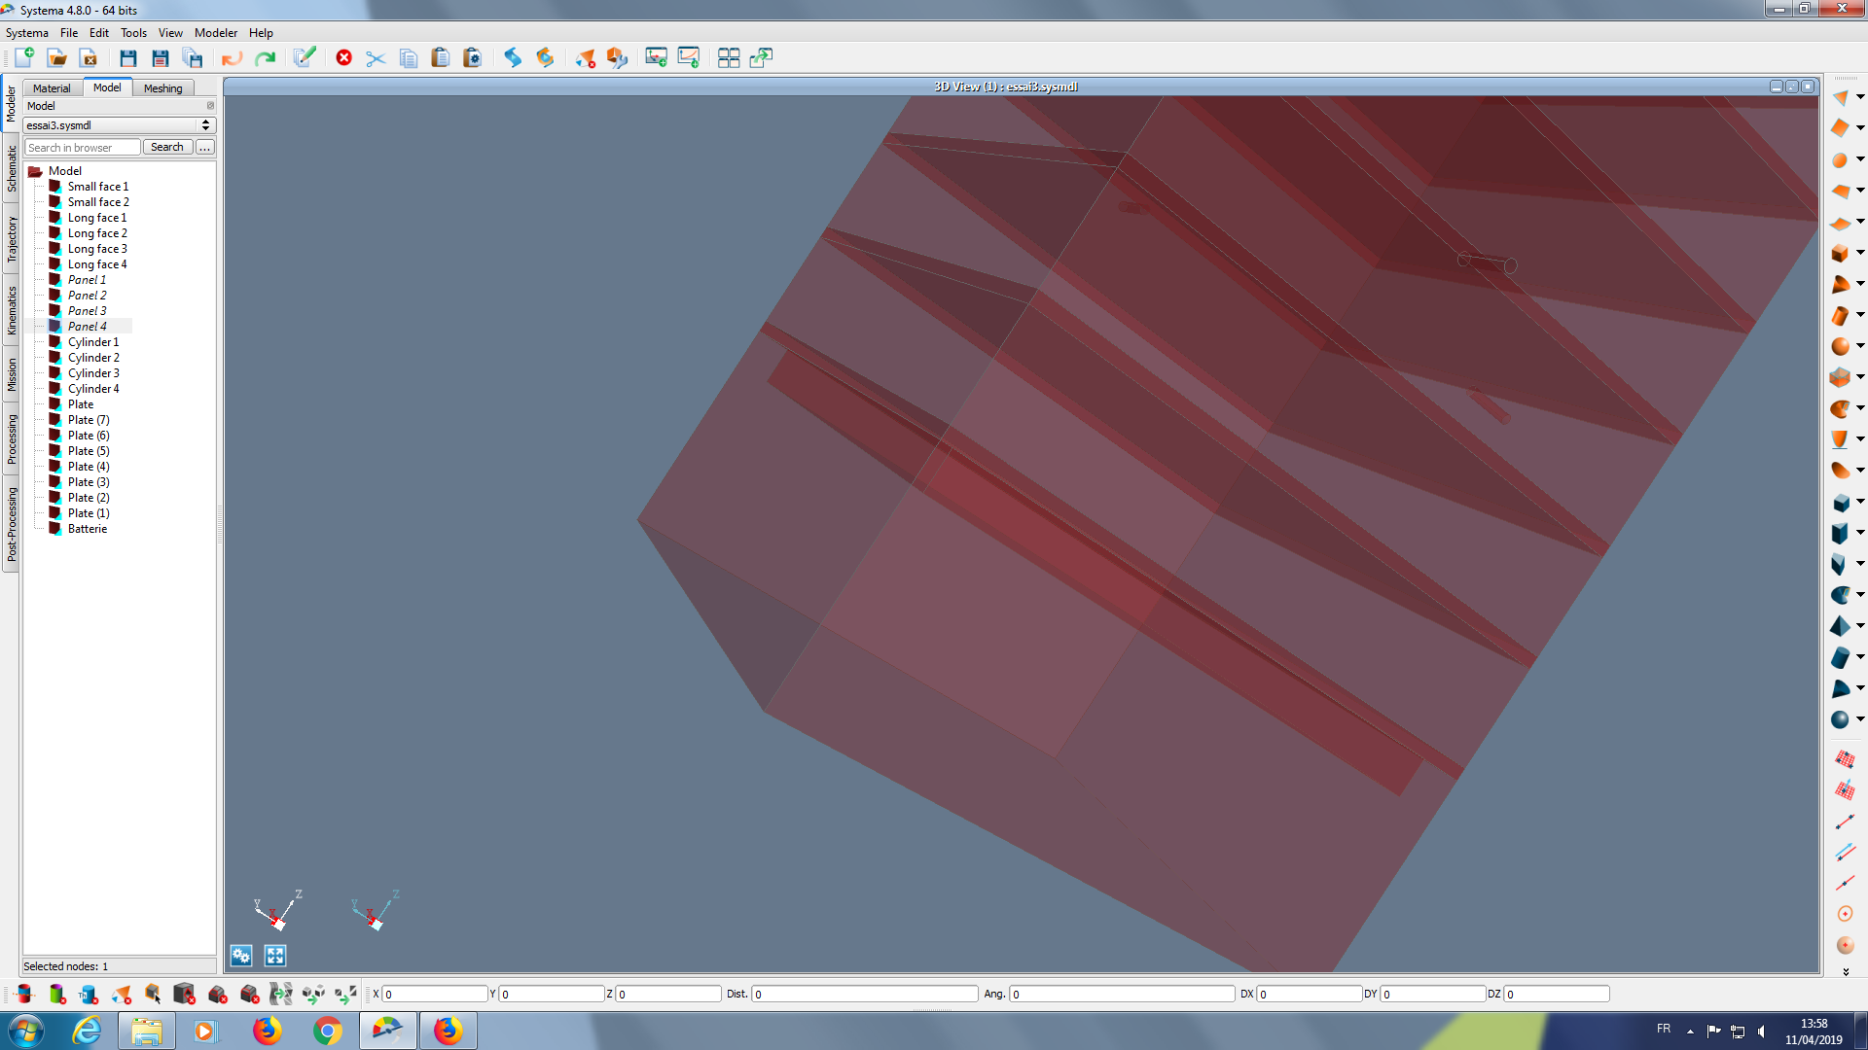
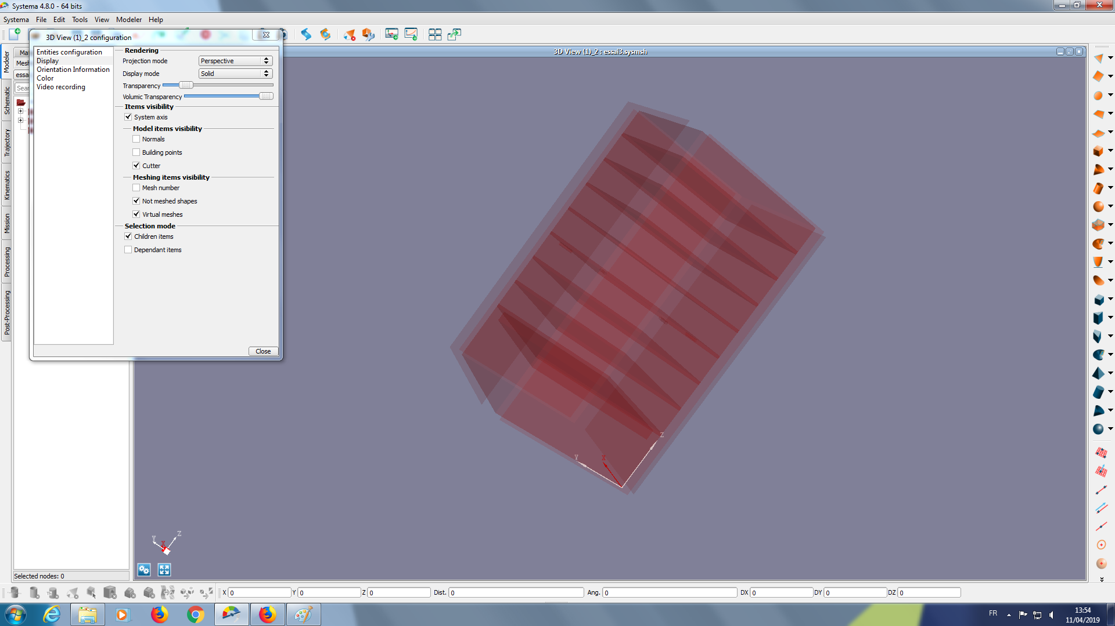
SOLAR PANEL
PLATES
FINAL ASSEMBLY
BATTERY
I - Objectives and Modelisation

Slide 6
Meshing parameters :
1
6
6
2
6
Solar panel link
10
Small faces
Big faces
I. Objectives and Modelling

Slide 7
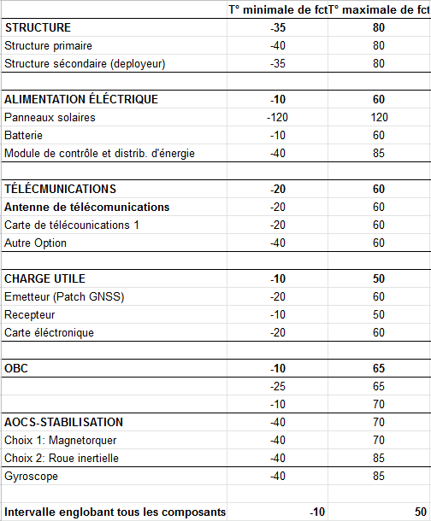
Thermal objectives for our Cubesat :
Temperature range of our solar panels : -120 / 120 °C
Temperature range of our components : -10 / 50 °C
I. Objectives and Modelling
°C

Slide 8
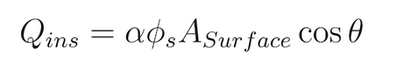
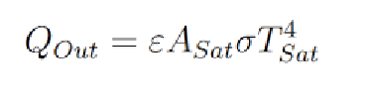
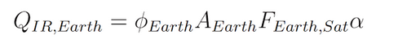
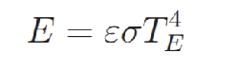
Methods of Temperature Calculation
Solar Power
Cubesat Power
IR Earth Power
Albedo Earth Flux
I. Objectives and Modelling
°C

Slide 9
II - Results of Thermica simulation
Several modes : - Tumbling mode : after the launch the Cubesat spin
Earth Pointing mode
Outer Space Pointing mode : opposite of the earth pointing one
Duration of the simulation : 50 000 seconds = 14 hours
Note: The simulation does not considerate the thermal dissipation of the battery !
II. Results of Thermica simulation

Slide 10
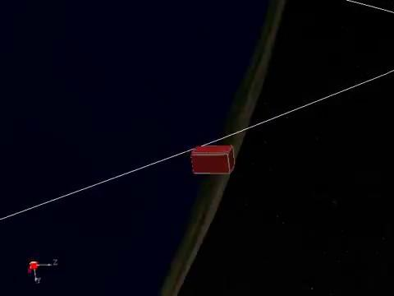
Tumbling mode :
After the launch from the ISS
II. Results of Thermica simulation

Slide 11
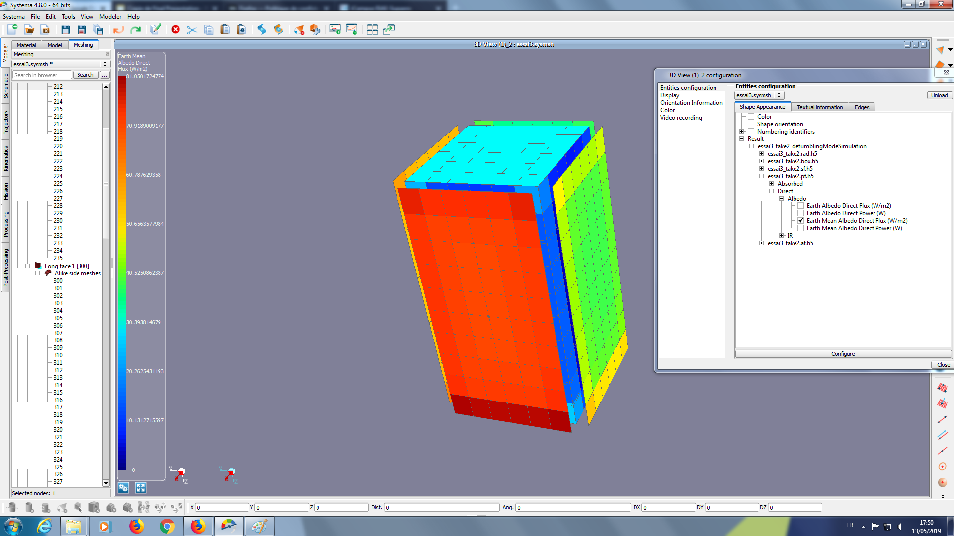
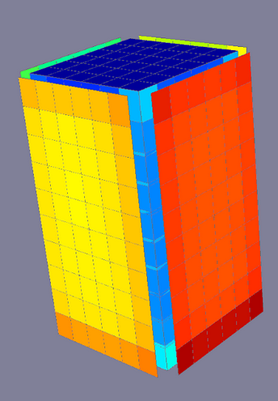
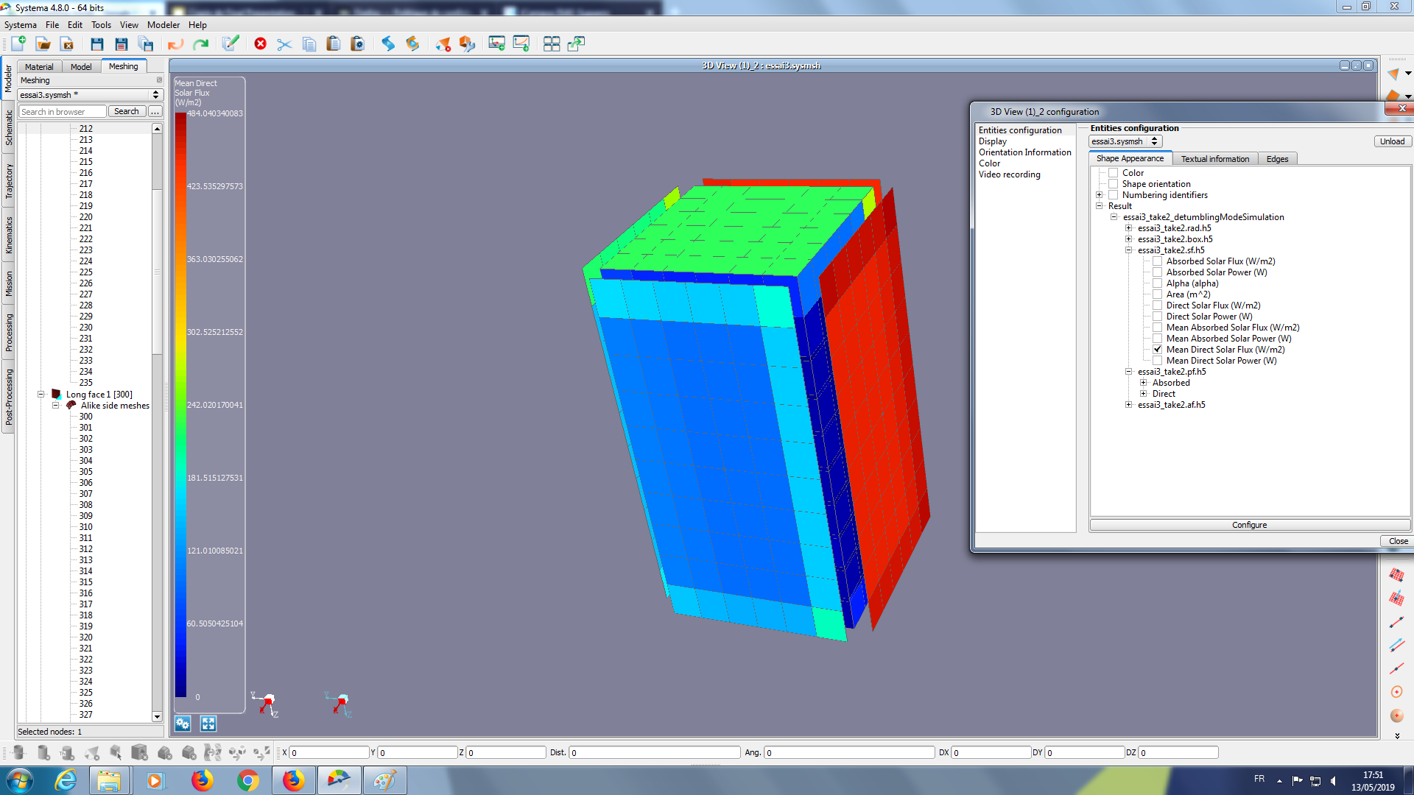
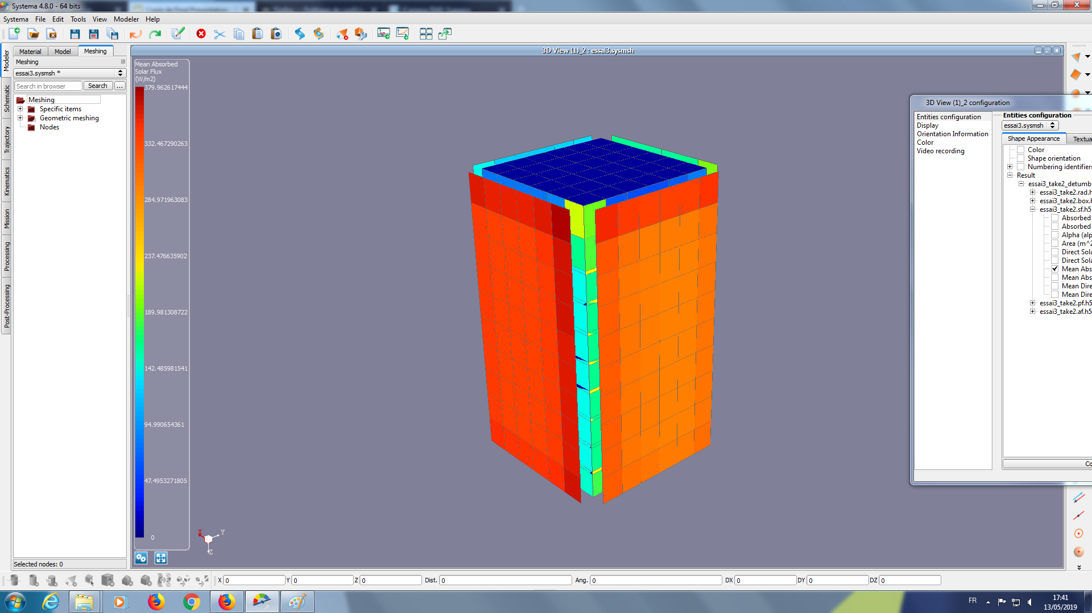
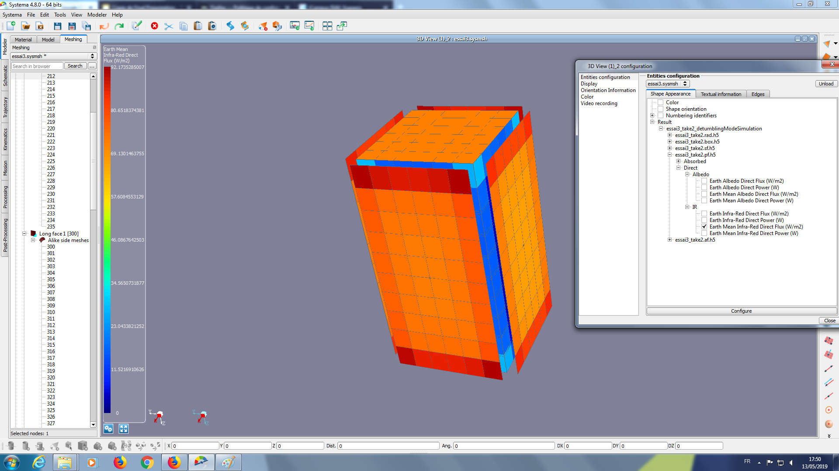
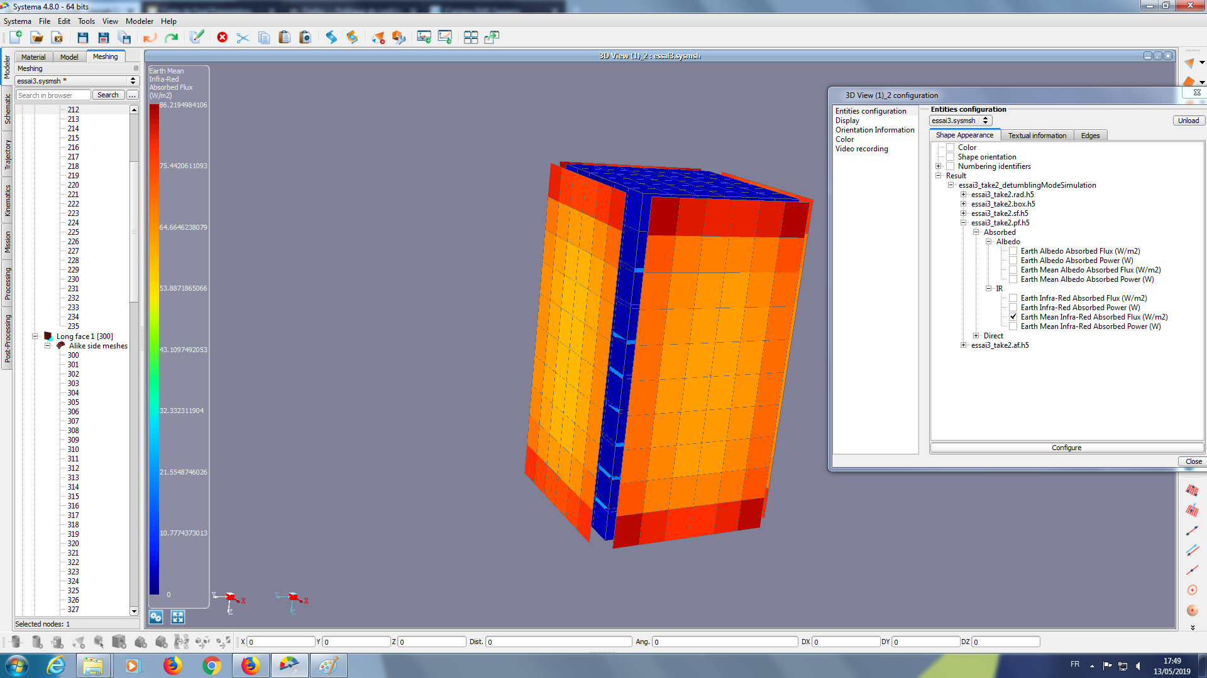
Tumbling mode (mean flux during simulation time) :
Tumbling mode (after lunch): Solar panel got the max mean flux
Earth Albedo Direct & Absorbed:
Max Direct Albedo 81 W/m²
Max Absorbed Albedo is 62 W/m²
Earth Infrared Direct & Absorbed :
Max Direct Infrared 92 W/m²
Max Absorbed Infrared 86 W/m²
Mean Solar Flux Direct & Absorbed:
Max Direct Solar Flux 484 W/m²
Max Absorbed Flux 380 W/m²
Earth Albedo- Direct vs Absorbed
Solar Flux- Direct vs Absorbed
Earth Infrared- Direct vs Absorbed
II. Results of Thermica simulation

Slide 12
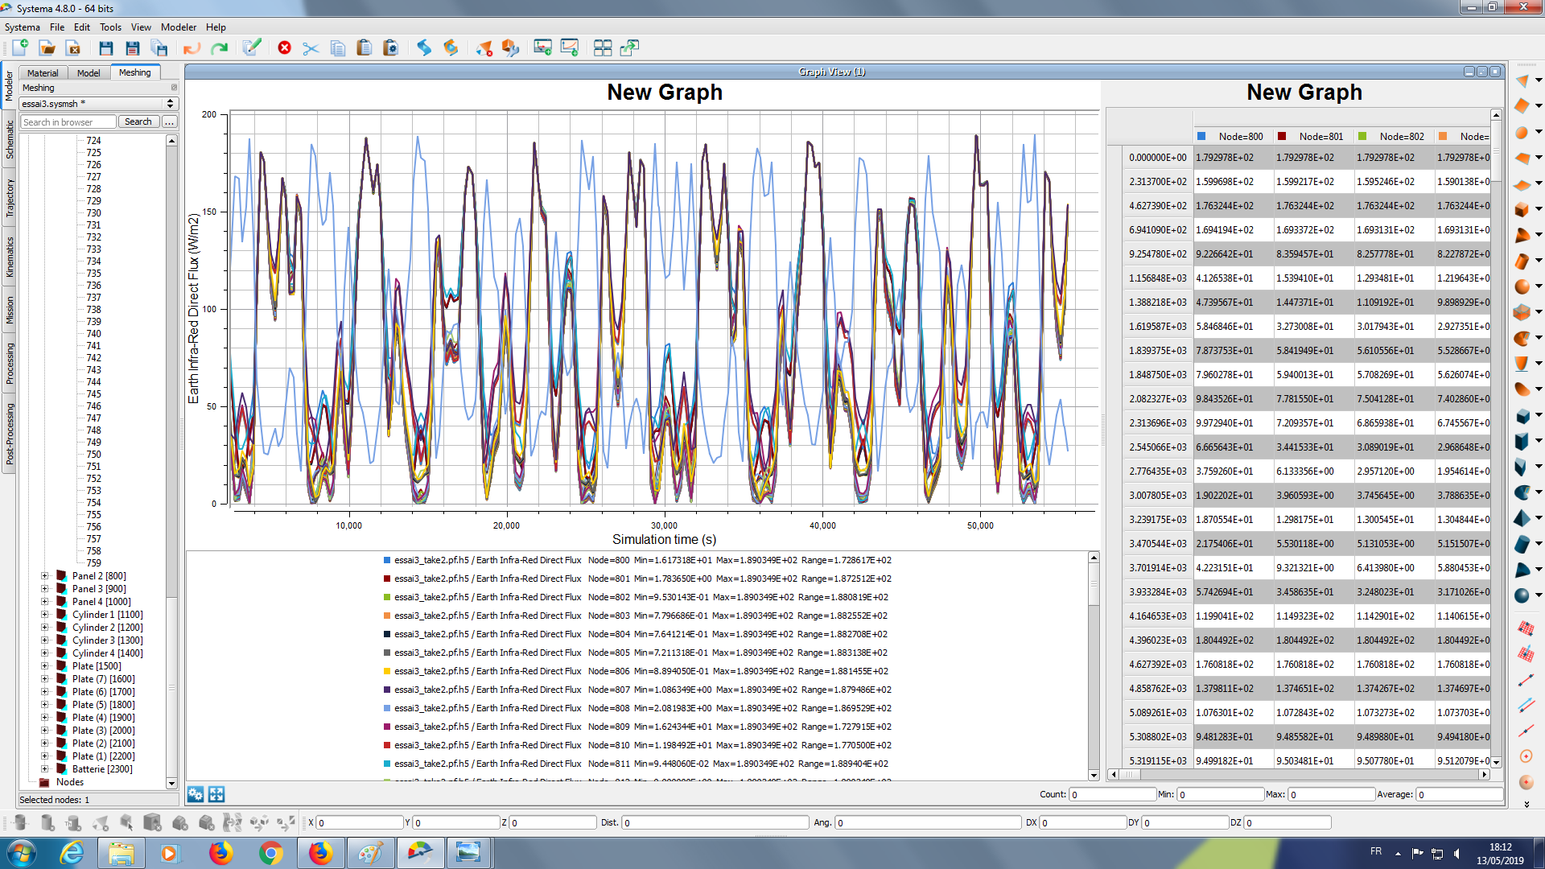
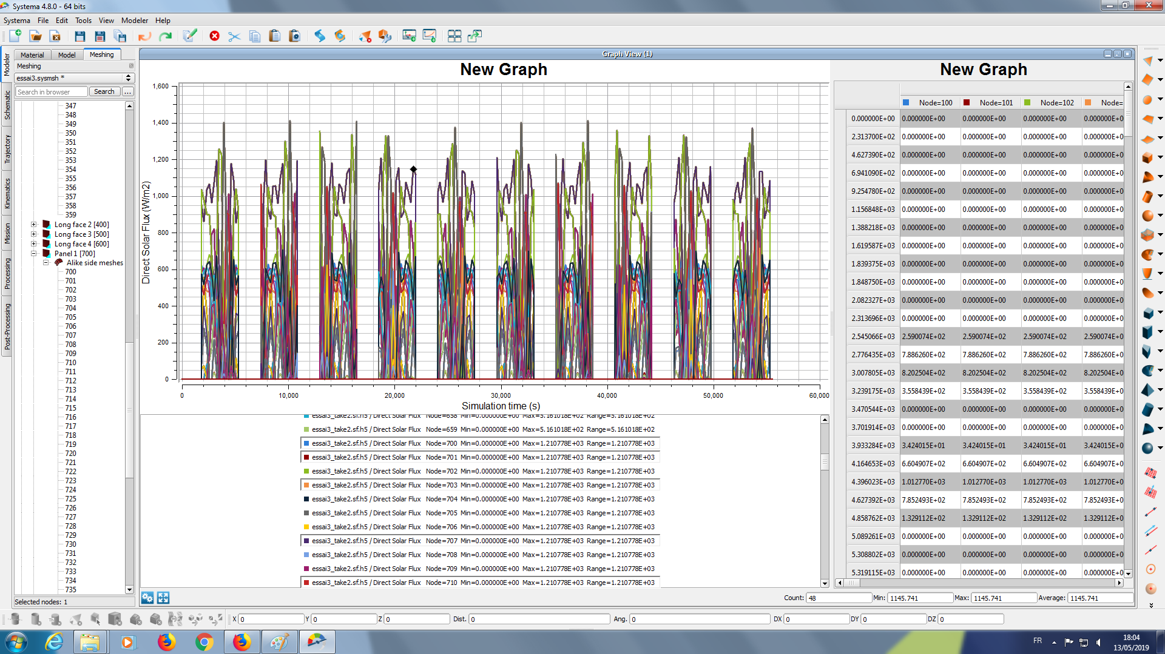
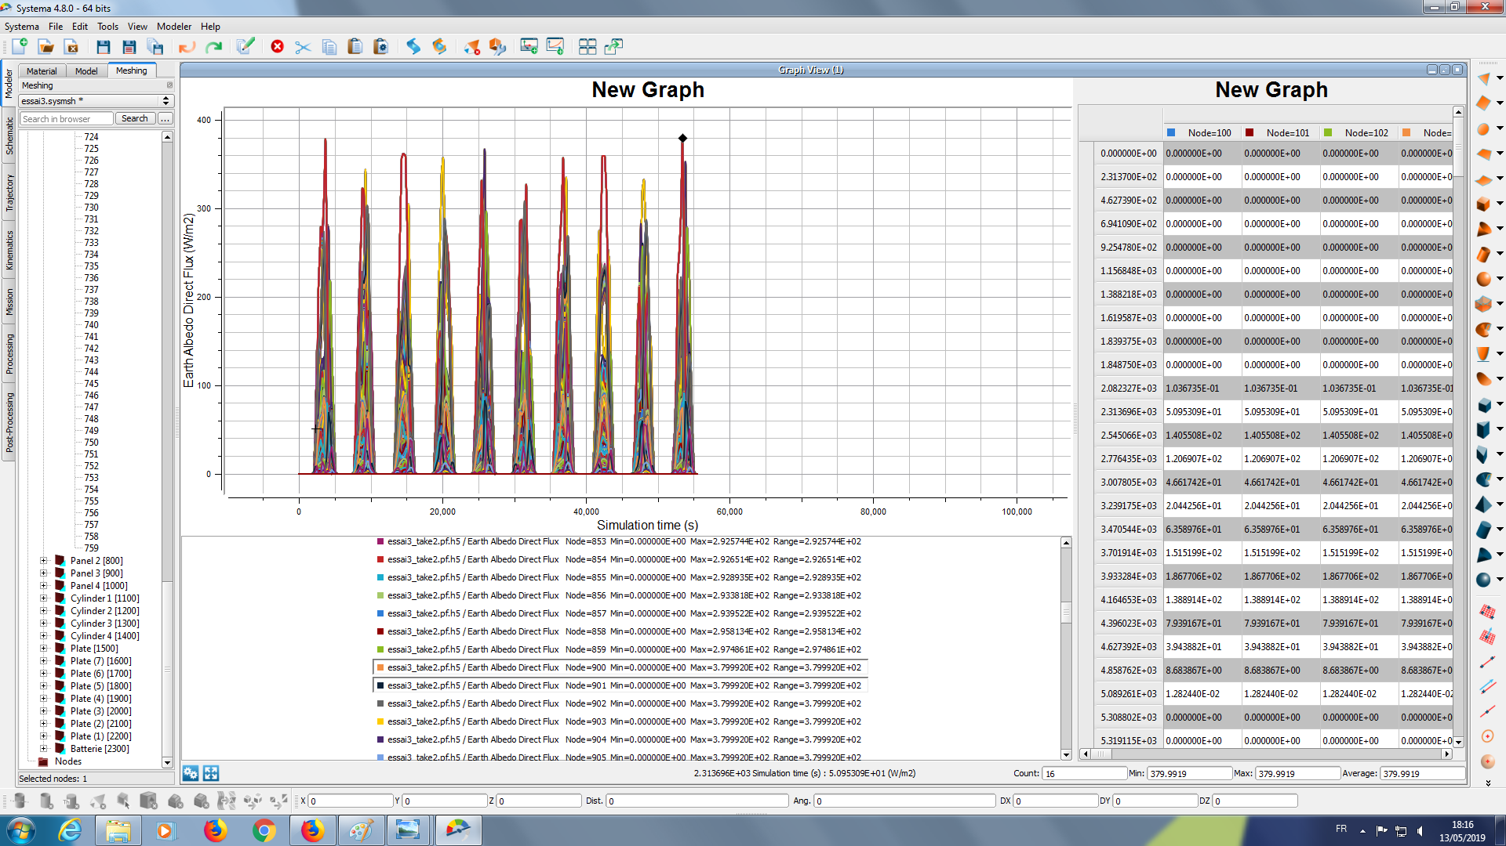
Tumbling mode :
Graphical Analysis
MAXIMUM TEMPERATURE:
111.7°
MAXIMUM TEMPERATURE SOLAR PANELS:
120°
MINIMUM TEMPERATURE:
-33.7°
MINIMUM TEMPERATURE SOLAR PANELS:
-120°
MINIMUM TEMPERATURE:
11.6°
MINIMUM TEMPERATURE SOLAR PANELS:
-120°
II. Results of Thermica simulation

Slide 13
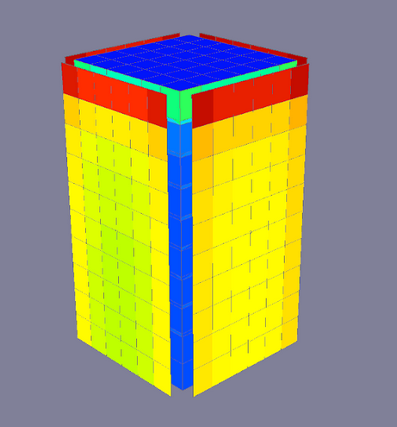
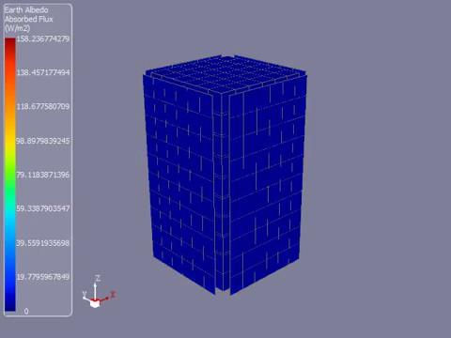
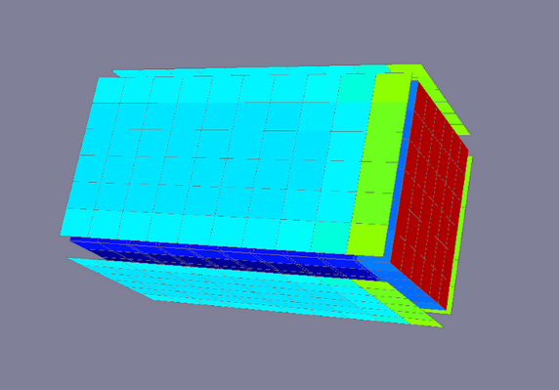
Earth pointing mode (mean flux during simulation time) :
Earth Albedo : Maximum of 160 W/m² on the top side of the solar panel
Earth Infrared :
Maximum of 190 W/m² on the top side facing earth
Earth pointing
Mean Earth Albedo
Mean Earth Infrared
II. Results of Thermica simulation

Slide 14
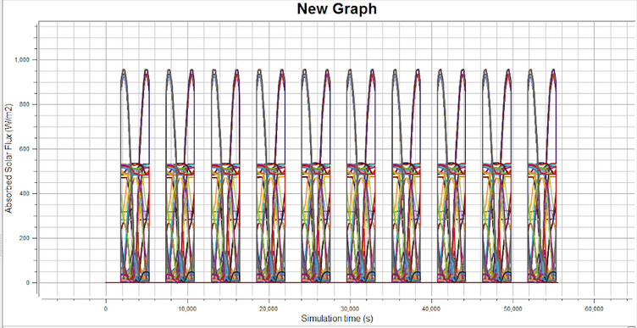
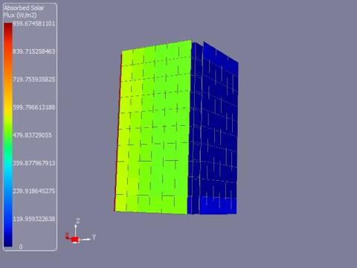
Earth pointing mode :
Earth pointing mode:
Solar Flux :
Solar Flux maximum value is 950 W/m² on the solar panel.
Core of cubesat maximum flux is 550 W/m²
Solar Flux on each nodes during the simulation
II. Results of Thermica simulation

Slide 15
Earth pointing mode :
Earth pointing mode:
Solar Flux :
With 950 W/m², considering
the solar panel (emissivity = 0.78),
with the stefan boltzmann law
we have T = 81 °C < 120 from
solar panel datasheet.
Solar Flux on each nodes during the simulation
II. Results of Thermica simulation

Slide 16
Outer space mode :
Outer space pointing mode:
This mode is the opposite from the earth pointing mode, value are the same
II. Results of Thermica simulation

Slide 17
Conclusion
Temperature is calculated here with direct flux for maximum & absorbed for minimum (to have margins) | Requirements | Tumbling mode | Earth pointing mode (= outer space)
Solar Panel (emissivity = 0,78) | -120/120 °C | -93/111,7 °C | -120/81 °C
Inside the CS (emissivity = 0,9) | -10/50 °C | -93/26 °C | -125/36 °C
Inside the cubesat the temperature is lower for the hot case (direct solar flux)
and higher for the cold case (direct earth flux)
Dissipation inside the cubesat maintain the temperature up to -10°C
Conclusion

Slide 18
Conclusion
Tumbling mode regarding Solar Flux is the worst hot case with 1400 W/m² (T = 143 °C > 120) on the solar panel.
The width of the pic = 500 seconds (8 minutes)
Finally : No active system needed, paint & coating could be necessary for extend thermal margin
As OBC Team suggested, Thermal probe inside the CS can be useful for monitoring
To achieve in phase B :
Run same simulation with all choosen components
Integrate dissipation part to the simulation and beware the max temperature of the CS
Conclusion

